Slide 1
Implementation of Logic programming using LISP /PROLOG-DFS for water jug problem / BFS for tic-tac-toe problem/ Hill-climbing to solve 8- Puzzle Problem.
Practical No. 1

Slide 2
Logic programming
Programming languages are of two kinds:
- Procedural (BASIC, ForTran, Pascal ,C++, Java).
- Declarative (LISP, Prolog, ML).
In procedural programming, we tell the computer how to solve a problem.
In declarative programming, we tell the computer what problem we want solved. (you do not write out what the computer should do line by line)
The general idea behind declarative languages is that you describe a situation.
- Based on this code, the interpreter or compiler will tell you a solution.

Slide 3
Why Prolog is not as popular as C/Java?
Mistaken at first as some universal computer language.
Not yet as efficient as C.
Support to Prolog takes effort, resources; companies are not willing to pay for it.
Its value not recognized by industry.

Slide 4
Prolog
“Programming with Logic“
Very different from other (procedural) programming languages.
Good for knowledge-rich tasks.
Prolog is a computer programming language that is used for solving problems that involve objects and the relationships between objects.
In Prolog, the word "object" does not refer to a data structure that can inherit variables and methods from a class, but it refers to things that we can represent using terms.
A Prolog program consists of clauses. Each clause terminates with a full stop.

Slide 5
Basic idea of Prolog
Describe the situation of interest.
Ask a question.
Prolog logically deduces new facts about the situation we described.
Prolog gives us its deductions back as answers .

Slide 6
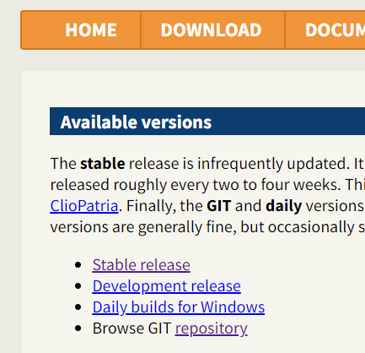
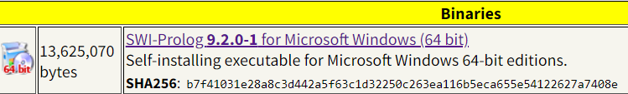
Prolog - Environment Setup
Install Prolog using the link below
https://www.swi-prolog.org/Download.html
Click on this

Slide 7
Basic Programs
Go thru the urls from basics to Basic Programs
https://www.tutorialspoint.com/prolog/index.htm
Example.1pl
Example2.pl

Slide 8
Example 3 - How to add, subtract, multiply, dive two numbers
Exam Question
Operator | Meaning
X > Y | X is greater than Y
X < Y | X is less than Y
X >= Y | X is greater than or equal to Y
X =< Y | X is less than or equal to Y
X =:= Y | the X and Y values are equal
X =\= Y | the X and Y values are not equal
Operator | Meaning
+ | Addition
- | Subtraction
* | Multiplication
/ | Division
** | Power
// | Integer Division
mod | Modulus

Slide 9
Exercise 1 - Simple program using prolog
https://github.com/siddydutta/AI-Lab-Sem7/blob/master/Practical%208%20-%20Introduction%20to%20Prolog.pl
Excercise1 Relationship.pl

Slide 10
Exercise 2 - Tic-Tac.Toe Problem:
Theory: A board game (such as tic-tac-toe) is usually programmed as a state machine. Looking on the current-state and therefore the player’s move, the game goes into the next-state.
tit-tat-toe (or Noughts and crosses, Xs and Os) could be a paper and pencil for 2 players, X and O, who take turns marking the areas in an exceedingly 3×3 grid:
The player who succeeds in putting 3 individual marks in an exceedingly horizontal, vertical or diagonal row wins the game. Players shortly discover that best play from each party ends up in a draw.
The game is generalized to an m,n,k-game during which 2 players alternate putting stones of their own colour on an m×n board, with the goal of obtaining k of their own colour in a row. Tit-Tat-Toe is the (3,3,3)-game.

Slide 11
Exercise 3 - Water jug problem
In the water jug problem in Artificial Intelligence, we are provided with two jugs: one having the capacity to hold 3 gallons of water and the other has the capacity to hold 4 gallons of water.
There is no other measuring equipment available and the jugs also do not have any kind of marking on them. So, the agent’s task here is to fill the 4-gallon jug with 2 gallons of water by using only these two jugs and no other material. Initially, both our jugs are empty.
1. (x,y) If x<4 (4,y) Fill the 4 gallon jug completely
2. (x,y) if y<3 (x,3) Fill the 3 gallon jug completely
3. (x,y) If x>0 (x-d,y) Pour some part from the 4 gallon jug
4. (x,y) If y>0 (x,y-d) Pour some part from the 3 gallon jug
5. (x,y) If x>0 (0,y) Empty the 4 gallon jug
6. (x,y) If y>0 (x,0) Empty the 3 gallon jug
7. (x,y) If (x+y)<7 (4, y-[4-x]) Pour some water from the 3 gallon jug to fill the four gallon jug
8. (x,y) If (x+y)<7 (x-[3-y],y) Pour some water from the 4 gallon jug to fill the 3 gallon jug.
9. (x,y) If (x+y)<4 (x+y,0) Pour all water from 3 gallon jug to the 4 gallon jug
10. (x,y) if (x+y)<3 (0, x+y) Pour all water from the 4 gallon jug to the 3 gallon jug

Slide 12
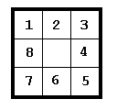
Exercise 4 - The 8-puzzle
The title of this section refers to a familiar and popular sliding tile puzzle that has been around for at least forty years. The most frequent older versions of this puzzle have numbers or letters an the sliding tiles, and the player is supposed to slide tiles into new positions in order to realign a scrambled puzzle back into a goal alignment. For illustration, we use the 3 x 3 8-tile version, which is depicted here in goal configuration

